Slide 1

- Mid-term Presentation -

Slide 2



Who is BTS?
More famous Koreans than Kimchi and Psy (Gangnam Style)
324 / 1000000 - according to newspaper in 2015.
Self Verification
The group's 2018 album, LOVE YOURSELF 轉 'Tear', debuted at No. 1 on the Billboard200
and No. 10 on the BillboardHOT100 , marking the highest rank as Asian artist in history
2017 and 2018 Billboard Music Awards BBMAs - Top Social Artist

Slide 3

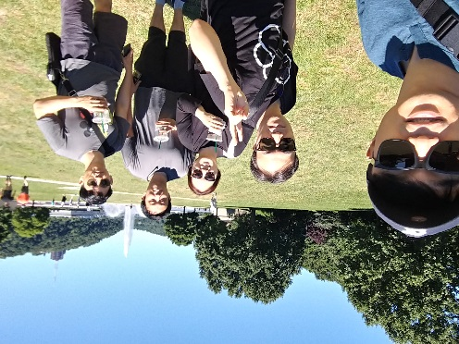
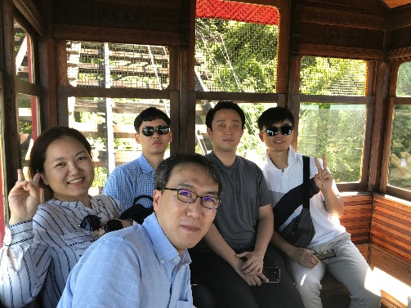
Team introductions
사진 cliff 함께 찍은걸 추가
이C. : 관련 내용 추가 /변경
Team Goal
“Understanding of SDET Culture and Techniques”,
not dancing or singing like BTS.
Team member / Main Role
Clifford C Huff / Mentor
Sungho Chin / Team & Project Lead
Jonggoo Lee / Code Review Lead
Sujung Lyu / Refactoring Lead
Jinhyuk Yang / Static Analysis Lead
Hyoyeon Hwang / Plan & Test Lead
Ground Rules
Every member should be involved in every quality management process.
5h for project / day, 1 project meeting / day, 1 mentoring meeting / week

Slide 4
Project introductions
프로젝트 goal 변경
Quality goal 을 정의
Measure 정의
이C
Project Goal
Making Bug-free Game. (at least No Major, Critical defects)
Focus on testability
not focus on simple coverage ratio
Quality Goals
Testability : line coverage : 90%, branch coverage : 80%, mutation coverage : 90%
Function’s Logical Correctness : Unit Test - pass 100%
Function’s suitability for new features : 60%
Usability (optional) : improve game command and message visibility (can be play the game with the less use ‘help’ command)
Discussion of collected data : team Wiki, JIRA, Sonar, GIthub
프로젝트 goal(quality goal 포함)
목표대비/달성도 비교 추가

Slide 5
Project Risk Management 추가
황S
Project Goal
TBD
focus on testability
=> not focus on simple coverage ratio
Quality Goals
Testability : line coverage : 90%, branch coverage : 80%, mutation coverage : 90%
Functional correctness : unit test - pass 100%
Functional suitability for new features : 60%
Usability (optional) : improve game command and message visibility (can be play the game with the less use ‘help’ command)
Discussion of collected data : team Wiki, JIRA, Sonar, GIthub
Risk management 추가
- Project & Product 관점에서 기술

Slide 6
Quality activities
유C
Code review : Team (Technical) Review
Pre-Test (optional) : It is not a formal quality system step
Ad-Hoc (Experience-based test design technique)
Refactoring : Sonar, testability
Unit test : White Box testing (statement testing, branch testing)
Integration test : Scenario testing (gray box)
System test : Scenario testing, Ad-hoc testing, Combination testing, BVA
2nd phase : for new features
Develop/Unit test
Code review
Integration test
System test
Project Results 쪽으로 이동
2nd Phase 부분을 삭제
개별 항목에 추가 활동 내용 반영

Slide 7
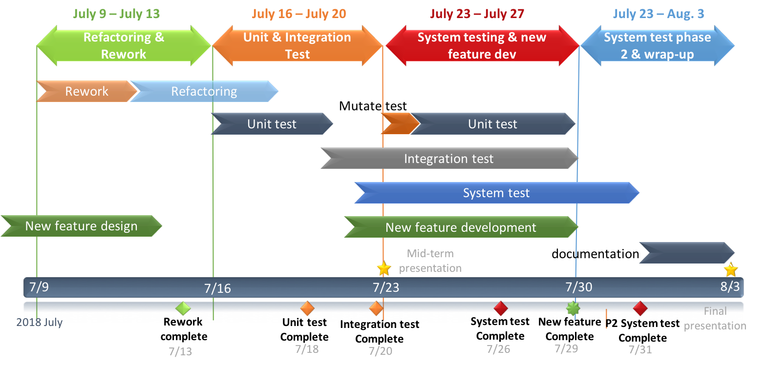
TBD Project Plans (?)
진C
계획대비/실제 실행을 표기 필요

Slide 8
Project Management
진C
누적 effort 대비/실적
ex) burndown
Burndown 비슷한 무엇으로 대체

Slide 9
Project Results - Defect Categorization
이C
Definition of Severity
Severity | Category | Defect Types
Critical | Functionality | Conflict to requirements
 | Reliability | Cirtical unstable issue. (can't proceed game)
Major | Maintainablity | Structural Odd Code (no consistant with other code)
 | Maintainablity | Static Analysis critical issue
 | Reliability | Memory handling issue
 | Functionality | Strange functional Operation
Minor | all defects except Critical, Major defect
Severity 정의
Lessen & learned.(?)
- 각 단계별로 severity 를 다르게 정의해야 하는가
Not Actual Data

Slide 10
Project Results - Defect Categorization
이C
Not Actual Data
- 단계별-severity 데이터 합치기
- 단계별 effort
Method / Tool with Severity

Slide 11
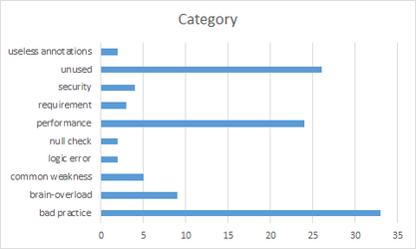
Quality activities – Static analysis
양S
Goal
Understanding system of Tartan Adventure.
Resource
Planned Effort: (6/21 ~ 26) 50h (2h * 5days * 5 members)
Outputs
number of Defects : 110
Lessons Learned
Vague requirements made code review hard.
.
관련 내용 추가
False alarm 분석
정적 분석 툴에 대한 특성 비교

Slide 12
Quality activities - Code Review
유C
Goal
Understanding system of Tartan Adventure.
checking correspondence between Spec. and Code
detecting Code defect
Resource
Planned Effort: (6/21 ~ 26) 50h (2h * 5days * 5 members)
Actual Effort : 36.5h
Outputs
number of Defects : 110
Lessons Learned
Vague requirements made code review hard.
Code review is one of good way to understanding System.
Understanding the tartan system
Ambiguous requirements and unexpected gaming behavior
숫자 현행화
Lesson & learned.수정

Slide 13
Quality activities - Pre-Test (optional) (삭제필요)
유C
Goal
Quality ‘smell’ of the tartan system
Review of requirements (at system level)
Resource
Planned Effort: (7/16) 2 h (Sujung Lyu)
Actual Effort : 5 h
Outputs
TestCase : 26 (ref. appendix. 3)
Defect : 15 (ref. appendix. 4)
Map of Game 16(ref. appendix 5)
Lessons Learned
Understanding the tartan system
Ambiguous requirements and unexpected gaming behavior
- 내용을 system test 에 반영하고 삭제

Slide 14
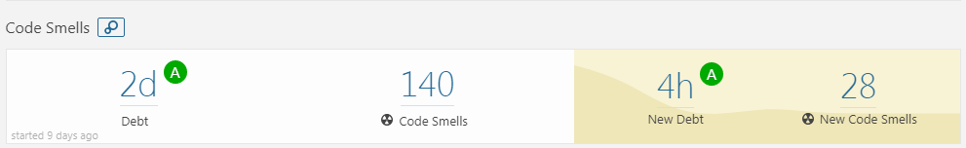
Quality activities - Refactoring & Re-Work
양S
- 결과물을 선명하게 나타낼 수 있는 그림 or 지표 추가가 필요함
Goal
Improving Testability
Improving Code smells in SonarQube (by 1day debt)
Resource
Planned Effort: (7/9 ~ 13) 50h (2h * 5days * all members)
Actual Effort : 31h
Outputs
Refactoring status : number of refactoring items (69) (ref. appendix.1)
SonarQube trend: (ref. appendix.2)
Lessons Learned
Refactoring is indispensable for Testability
Monitoring method for Field Status is needed to know changed status.
- For this, We discussed for changing private fields to public fields
- Finally, we added getter & setter methods.
Method should return about that’s result of procedure.

Slide 15

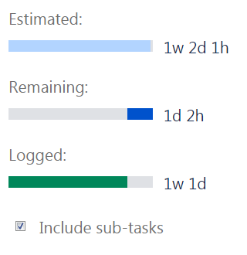
Quality activity – Unit test
양S
Goal : Satisfying code coverage
Completion criteria
90% statement coverage
80% branch coverage
Resource
Planned Effort : 45h (7/16~20, 3 hours a day, all members)
Actual / estimated Effort : 64h/73h
Outputs (ref. appendix.4)
number of unit-test : 241
coverage : statement coverage : 88%, branch coverage : 85%
Defect list : 4 (SDET-47, SDET-48, SDET-51, SDET-54)
Lessons Learned
Should simple code be included in the Unit test?
→ Our team's decision: don’t include
To effectively write the Unit test, we need a detailed specification.
- Goal 변경
* unit 단위의 기능확인 및 defect 검출
Lesson & learned
Defect 숫자가 적은 이유를 기술
Coverage 결과 업데이트
1)
1) methods without conditional statements, getter/setter methods
Notes:
예상 질문
유닛테스트 작성을 위해 디테일한 스펙을 정리 했는가?

Slide 16
Quality activity – Mutation Test 추가
황S
Goal : Satisfying code coverage
Completion criteria
90% statement coverage
80% branch coverage
Resource
Planned Effort : 45h (7/16~20, 3 hours a day, all members)
Actual / estimated Effort : 64h/73h
Outputs (ref. appendix.4)
number of unit-test : 241
coverage : statement coverage : 88%, branch coverage : 85%
Defect list : 4 (SDET-47, SDET-48, SDET-51, SDET-54)
Lessons Learned
Should simple code be included in the Unit test?
→ Our team's decision: don’t include
To effectively write the Unit test, we need a detailed specification.
-관련 내용으로 현행화
1)
1) methods without conditional statements, getter/setter methods
Notes:
예상 질문
유닛테스트 작성을 위해 디테일한 스펙을 정리 했는가?

Slide 17
Quality activity – Integration test (수정필요)
황S
Goal : Verify core sequence consistency (Risk based test)
Completion criteria
Test case result : 100% pass
Resource
Planned Effort : 45h (7/18~20, 2hours a day, all members) -> 19h 30m
Actual Effort : 15h 40m
Outputs
Test case : 11 (ref. appendix.5 )
pass rate : : 100 %
Defect list : 1 (SDET-46) (appendix. 5)
Lessons Learned
In the tartan project, the modules are already integrated, should we do the integration test?
New feature 내용 위주로 재구성
기존 내용은 effort. 관련된 데이터 위주로 재사용
Notes:
예상 질문

Slide 18
Quality activity - System test (현행화
유C
Goals
Verify requirements from the user's perspective.(2018LGSDETProject.pdf)
Especially, Use-Cases will be mainly verified.
Resource
Total Man Hours : 50 hours (5days / 5 hours per day / 2 members)
Periods : 7/19~25
Outputs
System Test Case
Test Result
Defect List (it is managed by JIRA System)
Argument Point
should we have to implement automation test system?
테스트 적용 기법 기술
데이터 현행화
- Lesson & learned 추가

Slide 19
New Feature 신규 개발 내용 (아키텍처 위주 정리)
진C
Goals
Verify requirements from the user's perspective.(2018LGSDETProject.pdf)
Especially, Use-Cases will be mainly verified.
Resource
Total Man Hours : 50 hours (5days / 5 hours per day / 2 members)
Periods : 7/19~25
Outputs
System Test Case
Test Result
Defect List (it is managed by JIRA System)
Argument Point
should we have to implement automation test system?
Requirement 대비 개발 숫자
상세 requirement 는 유첨으로 정리

Slide 20
Tools
CI : Github + Jenkins (http://40.74.87.221:8080)+ sonaQube
Source repository : github (https://github.com/sunghochin/TartanAdventure)
Quality Tool : SonarQube (http://40.74.87.211:9000/projects)
document configuration : wiki page (https://sdet-bts.atlassian.net/wiki/spaces/SDET/overview)
issue tracker : jira (https://sdet-bts.atlassian.net/secure/RapidBoard.jspa?projectKey=SDET&rapidView=1)
Coverage library : jacoco, pitest
Auto trigger build
Static analysis
build
Coverage integration
source commit
Measure coverage

Slide 21
Q&A
Thank you for your attention!!

Slide 22
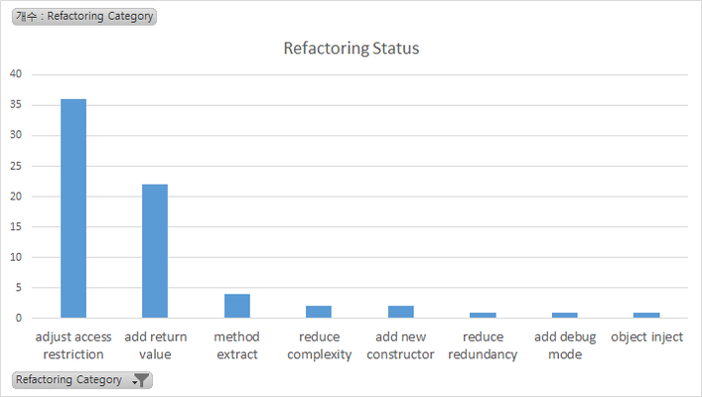
Appendix 1. Refactoring & Re-Work
Refactoring Status
Category | num | Graph
adjust access restriction | 36
add return value | 22
method extract | 4
reduce complexity | 2
add new constructor | 2
reduce redundancy | 1
add debug mode | 1
object inject | 1

Slide 23
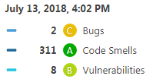
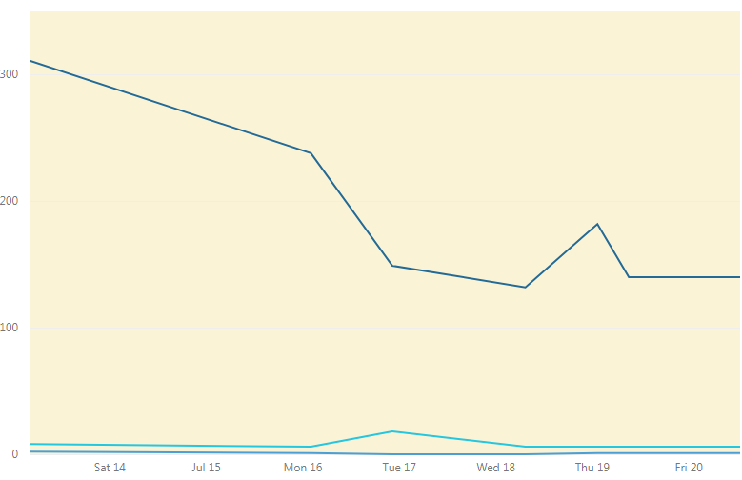
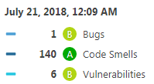
Appendix 2. Refactoring & Re-Work
SonarQube Trand

Slide 24
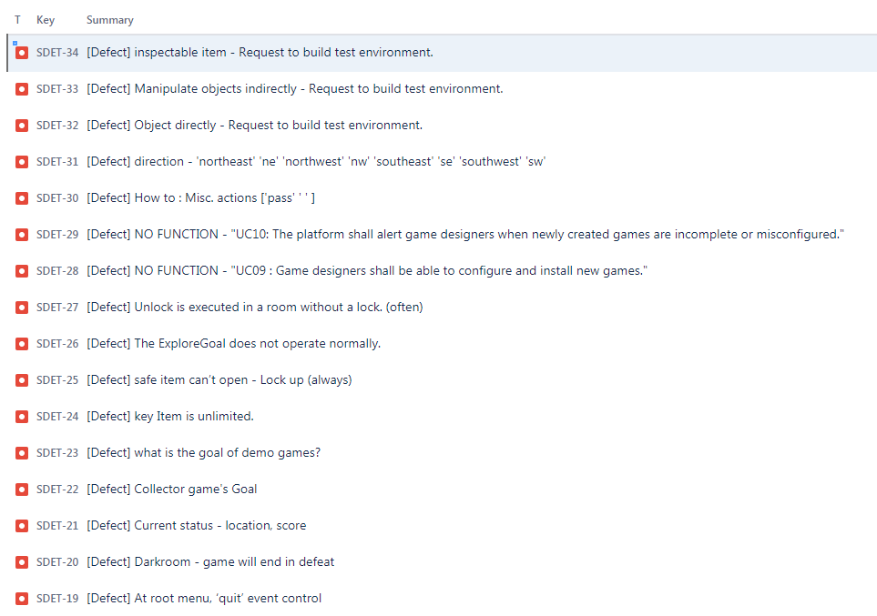
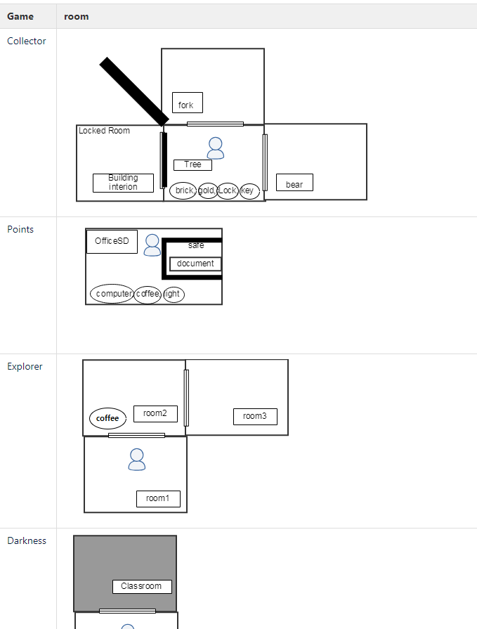
Appendix 3. Pre-Test outputs
Defect : 16
Game Map

Slide 25
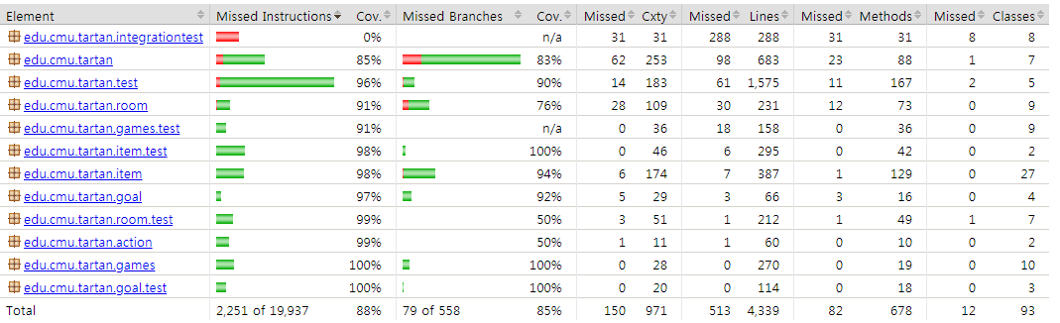
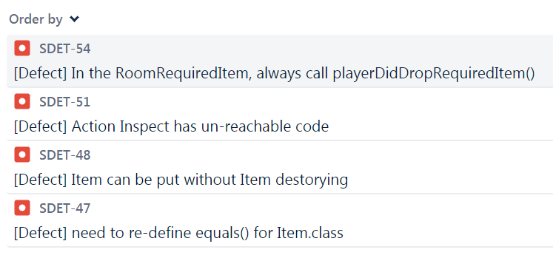
Appendix 4. Quality activity – Unit test
Coverage
Defect list
Notes:
예상 질문
유닛테스트 작성을 위해 디테일한 스펙을 정리 했는가?

Slide 26
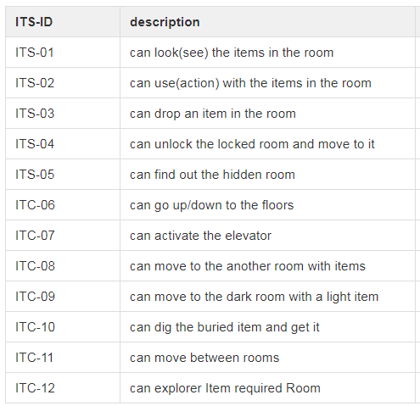
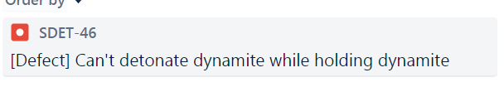
Appendix 5. Quality activity – Integration test
Test case
Defect list
Notes:
예상 질문

